Slide 1

Image scrapping &
classification
project
Presented By-
Shilpa Kewalaramani

Slide 2
Contents
Introduction
Objective
Data Collection and Distribution in various folders
Data Collection Flowchart
Visualization of Data
Preprocessing of Data
Algorithms used to create model
Creating neural network
Key-Metrics used to check performance of model
Performance of model with 30 epochs
Limitations and Future scope of project

Slide 3
Introduction
Image Classification is a fundamental task that attempts to comprehend an entire image as a whole. The goal is to classify the image by assigning it to a specific label. Typically, Image Classification refers to images in which only one object appears and is analyzed. In contrast, object detection involves both classification and localization tasks, and is used to analyze more realistic cases in which multiple objects may exist in an image.
Earlier the word ‘data’ was used for representing some text information or some files containing details of some items and the data comprises of everything was in the format of ‘text’ . But today with the tremendous use of smart devices the data is generating at a speed of TB and the most important thing is today data not only refers to text but also to images.
Nowadays these images can also be classified just like the data is classified. Our this project shows the glimpse of it. First it collects the images from the e-commerce websites then it classifies into categories then trains the model and then predicts the images of the categories passed

Slide 4
objective
The main objective behind making this project is to make a model that takes the image as input and classifies it as either a saree, mens trouser or mens jeans

Slide 5
Data collection And its
distribution in various folder
In this project there was no data provided we were asked to collect the data from e-commerce website like amazon.in and then build a model and predict the data.
The data that was collected by us was the images of saree, mens jeans , mens trousers we were asked to collect minimum 200 images but in this project I collected all the images that were upto page 6 finally I collected 252 images of saree , 356 images of mens jeans and 356 images of mens trousers.
These all images were at first saved in different folders then 80% of the data was shifted to the Training Folder, This training folder had sub folder of theses three categories and 20% data was shifted to validation folder and few images to the testing folder

Slide 6
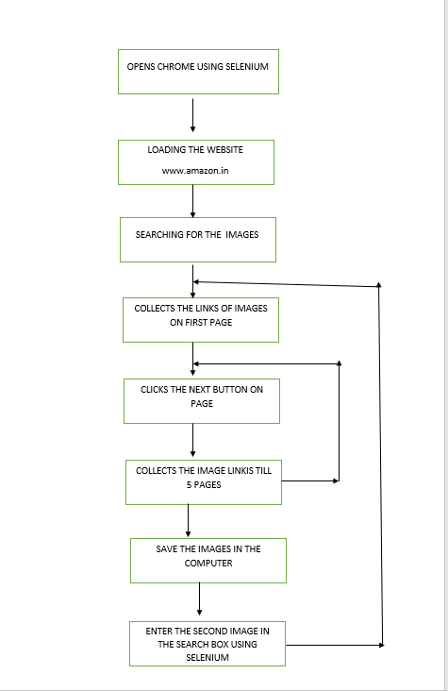
Data
collection
flowchart

Slide 7
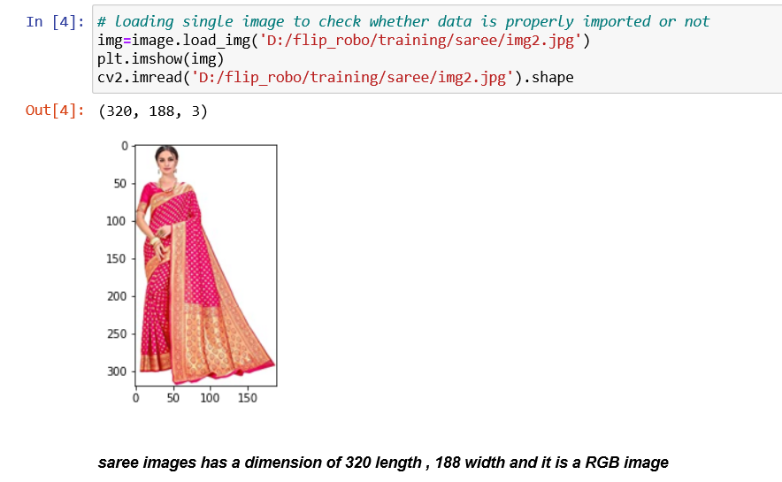
Visualization of data
Out of all the images that were saved through selenium in the different folders were visualized like one from each category just like of saree

Slide 8
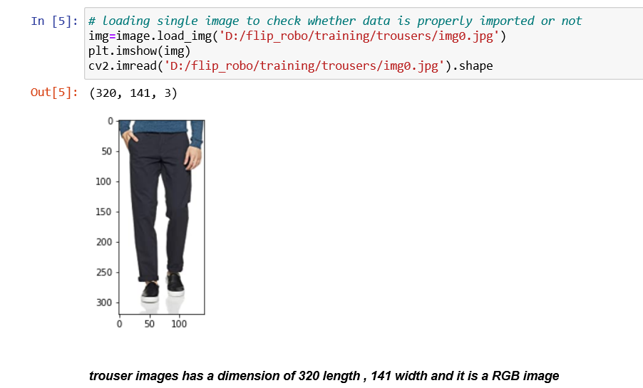
Visualization of data
Out of all the images that were saved through selenium in the different folders were visualized like one from each category .
Here we checked the image of Trouser

Slide 9
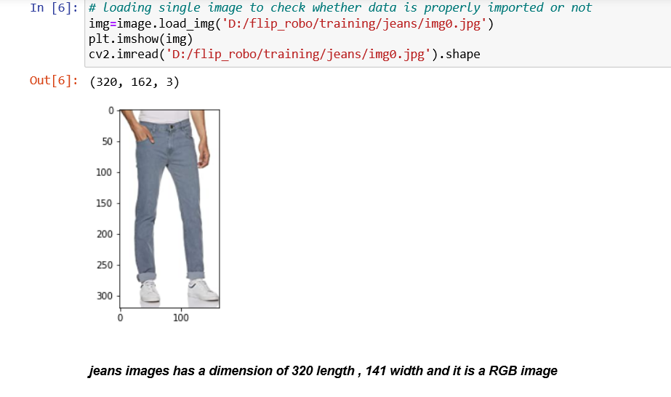
Visualization of data
Out of all the images that were saved through selenium in the different folders were visualized like one from each category .
Here the image of mens jeans is checked

Slide 10
PREPROCESSING OF DATA
During the project the image was converted to array using cv2 method
All the images was resized to common dimension of 320 length and 140 breadth
The whole data was divided by 255 to bring on the same scale between 0 to 1
Training data was again reshaped with (-1, width, height, channel)
Same things were done after loading the model for prediction.

Slide 11
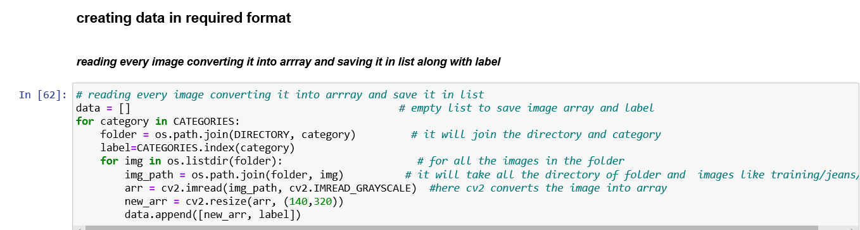
PREPROCESSING OF DATA

Slide 12
Algorithms used to create model
To read the directory-
os library is used
To load the image
cv2 library is used
To Process the image
ImageDataGenerator library is used it is imported from the tensorflow.keras.preprocessing.image
To Create the Models-
Sequential model was used. It was imported from tensorflow.keras.models
To Create Layers
i)Conv2D,
ii)MaxPooling2D,
iii)Dense,
iv)Flatten
these above layers were imported from tensorflow.keras,layers

Slide 13
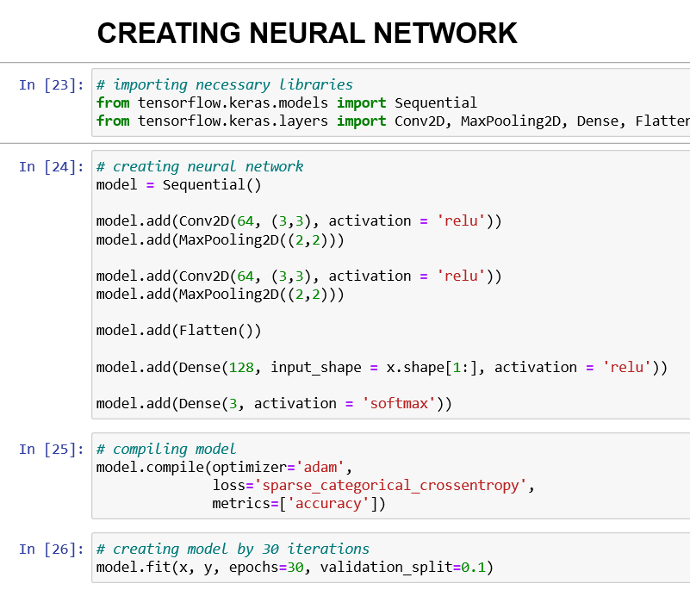
CREATING NEURAL NETWORK

Slide 14
Key Metrics used to check performance of model
1)Metrics = Accuracy
2) Loss= Sparse Categorical CrossEntropy

Slide 15
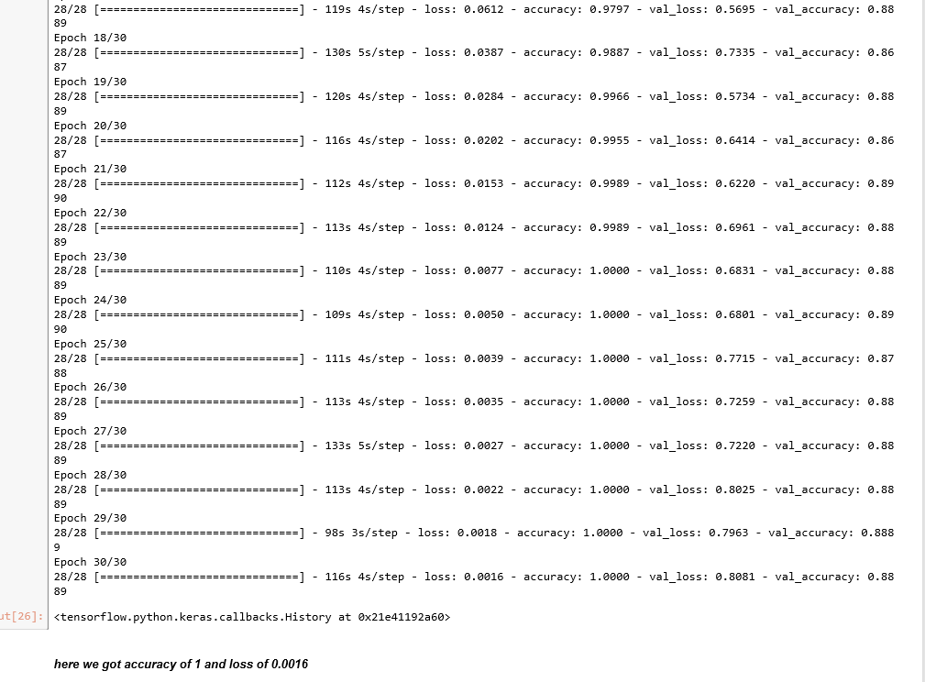
Performance of model with 30 epochs

Slide 16
Limitations and Future scope of project
Limitations
There was no limitation found in the project as it was simple short and easy project
Future Scope
In Future Scope we can add more categories of images to classify more items

Slide 17
Thank you

